Slide 1
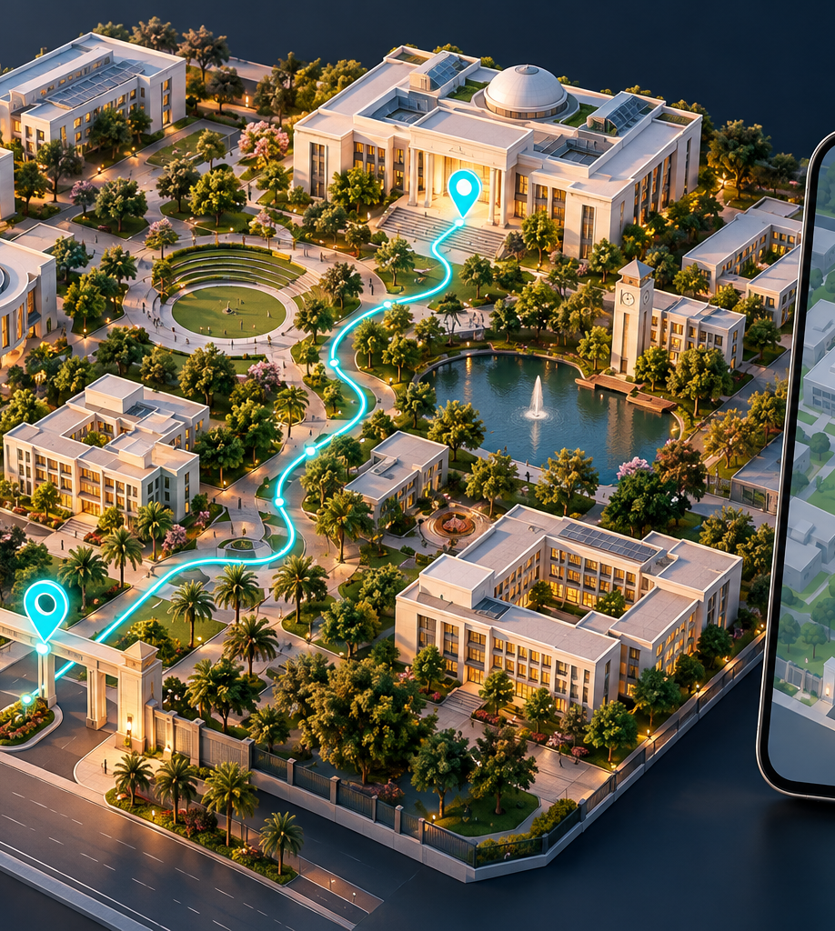
AI-BASED
Campus Navigation
and Route Finder
A proposed smart guide for students and visitors
Alex.d
Roll No: 25wu0101029
Manikanta Reddy
Roll No: 25wuo102321
Section: Wolves Class: B.Tech
Notes:
Presenter: Alex.d. Good morning. We are Alex.d and Manikanta Reddy from B.Tech, section Wolves. Our project is an AI-based campus navigation and route finder. It helps a student search for a place using everyday language and follow a verified campus route. This presentation describes a proposed prototype, not an already deployed product. Presenter roll numbers reproduce the user-provided identifiers, including the letter o in the second roll number. Image: AI-generated conceptual campus illustration.

Slide 2
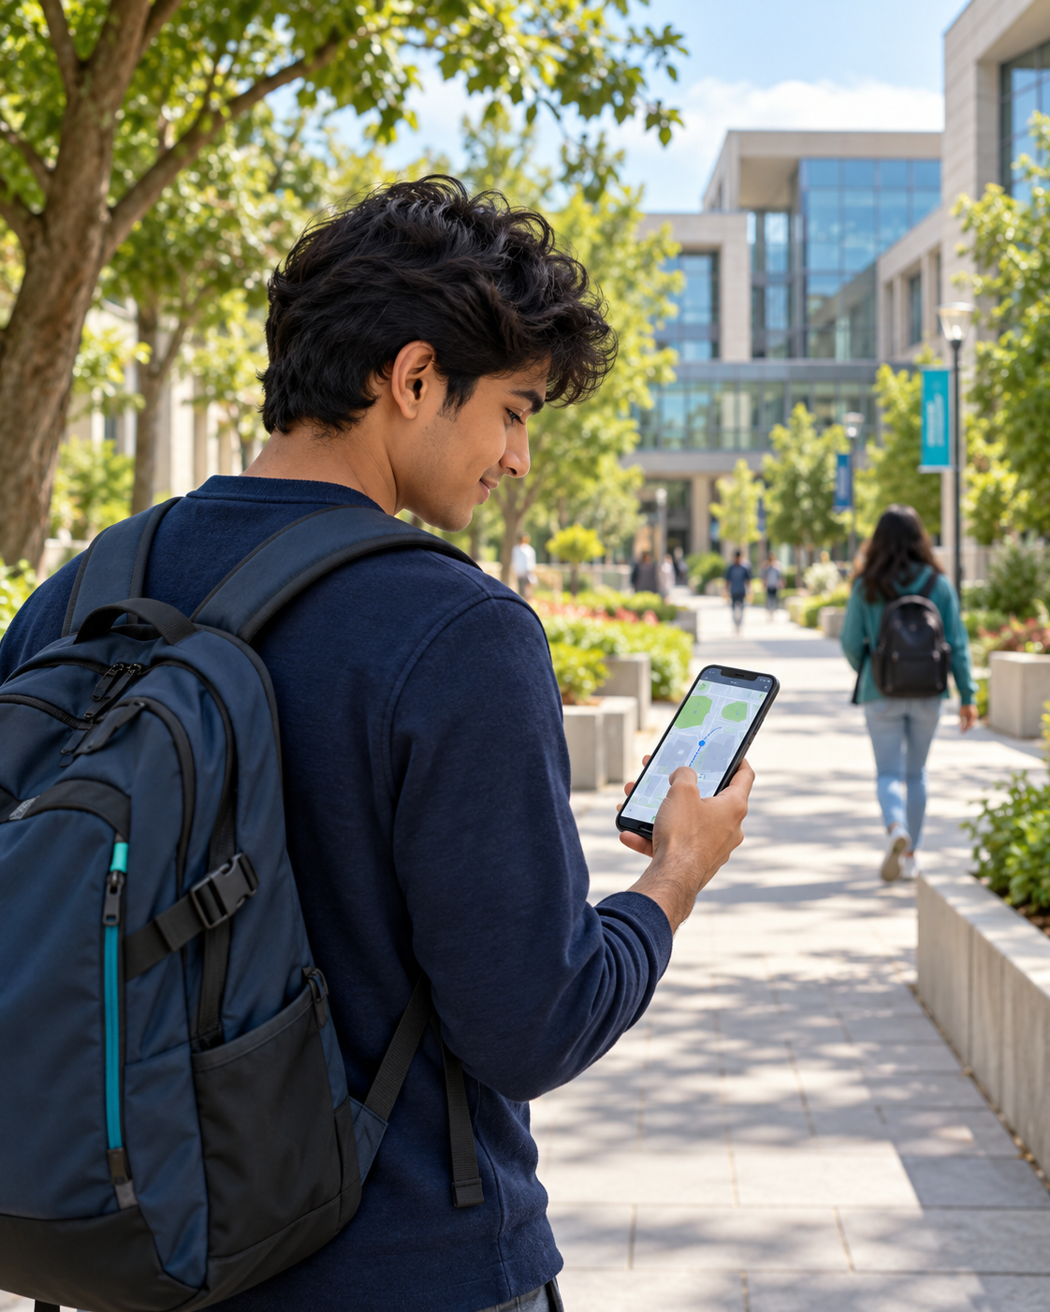
The problem and our proposed solution
The problem
New students and visitors struggle to find rooms, labs and the correct building entrance.
The product
A mobile app with a campus map, searchable destinations and step-by-step directions.
The benefit
Students can choose a direct or step-free route and see the distance and estimated arrival time.
02
Notes:
Presenter: Alex.d. A normal address search may identify a university, but our app uses the campus directory to locate specific rooms and entrances. The first prototype will cover a small verified part of the campus. It will support students, visitors and people who need step-free access. These benefits are intended outcomes and must be checked in user testing. Image: AI-generated illustrative student and fictional campus.

Slide 3
How the app works
1 Locate
2 Search
3 Find a route
4 Navigate
Use GPS outdoors.
Scan a location QR
code indoors.
Type or speak:
“Take me to
CSE Lab 2.”
Match the destination.
Apply access rules.
Calculate the path.
Follow map and
turn instructions.
Recalculate if needed.
Example journey
Main gate → Academic Block A entrance → Floor 1 → CSE Lab 2
Indoor prototype: floor maps and QR checkpoints identify known positions.
03
Notes:
Presenter: Alex.d. The journey starts by finding the current location with permission. GPS helps outdoors, while an indoor QR code identifies a surveyed checkpoint and its floor. The user enters a destination and the app confirms the correct place in the campus directory. The route service calculates a path and the app displays directions. Outdoor progress can update from location readings. Indoors, the proposed basic version updates at QR checkpoints and does not claim continuous room-level GPS tracking. If GPS is poor, the user can select a known start point. Handover: Manikanta will explain the AI and the implementation. Source: https://www.gps.gov/gps-accuracy explains signal blockage and indoor limitations.

Slide 4
How AI connects to the product
“Take me to the computer lab without stairs”
AI language model
Campus directory
Route engine
Extracts the place name
and the step-free request.
Returns a verified room ID.
Asks which lab if unclear.
Uses A* on mapped paths
and excludes stair edges.
AI understands the request. The graph algorithm calculates the route.
Optional later feature: a trained model can estimate busy-path travel times.
04
Notes:
Presenter: Manikanta Reddy. AI is connected at the language-understanding layer. The app sends a typed request, or text obtained from speech recognition, to a pretrained language model through the backend. The model extracts destination and access preferences in structured fields. A lookup validates the destination against approved room records. If there are two computer labs, the app asks the user to select one. A* then searches a weighted graph. This prototype does not require training a large model from scratch. A* is a classical search algorithm and can work without machine learning. The system must never invent a route or room. Later, with enough consented and representative observations, a separate model could predict travel time. Source for routing: https://networkx.org/documentation/stable/_modules/networkx/algorithms/shortest_paths/astar.html

Slide 5
How the route finder chooses a path
Illustrative campus graph
1 Build a graph
Library
Places are nodes. Walkways are edges with distance or time costs.
150 m
200 m
Gate
Block A
2 Apply rules
Remove closed paths and stairs when step-free access is selected.
200 m
Café
300 m
3 Search with A*
Choose the lowest-cost allowed path and return its directions.
Selected route: 350 m
Alternative route: 500 m
05
Notes:
Presenter: Manikanta Reddy. This is a simplified illustrative graph, not a measured campus map. The route through the library is 150 plus 200, or 350 metres. The route through the café is 200 plus 300, or 500 metres. For distance weights, A* can use straight-line distance as a lower-bound heuristic when coordinates and units are consistent. In A*, f(n) = g(n) + h(n), where g is the cost already travelled and h estimates the remaining cost. An overestimating heuristic can invalidate the shortest-path guarantee. A zero heuristic gives Dijkstra-style search. If a path closes, update the graph and run the search again. If no permitted route exists, display that result rather than inventing a path. Source: https://networkx.org/documentation/stable/reference/algorithms/generated/networkx.algorithms.shortest_paths.astar.astar_path.html

Slide 6
Implementation plan and system design
01
Map the campus
02
Build the backend
Survey buildings, rooms and walkways.
Record distances, floors and access rules.
Store the directory and route graph.
Connect AI search and A* through an API.
03
Develop the app
04
Test and improve
Add the map, search and GPS permission.
Show directions and indoor QR checkpoints.
Walk real routes and verify destinations.
Test closures, poor GPS and step-free access.
AI service
Flutter app
Python API
Campus database + graph
User request
A* route calculation
06
Notes:
Presenter: Manikanta Reddy. Stage one is a small campus survey with permission, followed by a database of approved destinations and connected path segments. Stage two is a Python backend with location lookup, language understanding and route calculation. Stage three is a Flutter application that requests location only when required and supports manual start selection or QR checkpoints. API credentials stay on the backend. Begin with outdoor navigation and one mapped building. Stage four compares routes against real walk-throughs. Record destination-match accuracy, successful arrivals, route correctness and response time. Test inaccessible routes, unknown rooms and loss of network. Campus staff need a way to update room details and closures. Implementation example: the app sends POST /route with a start node, a natural-language request and an access preference. The backend asks the AI service to extract destination and step_free, verifies the destination ID against the directory, removes closed or forbidden edges, and runs A*. It returns route node IDs, total distance and turn instructions. The app draws that route on the map. Store places as id, name, floor and coordinates, and paths as from_id, to_id, distance_m, stairs and closed. The suggested technology stack is a proposal, not a claim that the app has been built.

Slide 7
Thank You
Questions & Discussion
Alex.d & Manikanta Reddy
B.Tech • Section Wolves
Notes:
Presenters: Both. Thank you for listening. We welcome questions about the AI layer, campus mapping, route calculation and the prototype implementation.

